Slide 1
INTRODUCTION
The September 11 attacks (also referred to as 9/11) were four coordinated terrorist attacks by the Islamic terrorist group al-Qaeda against the United States on the morning of Tuesday, September 11, 2001. The attacks resulted in:
2,977 fatalities
More than 25,000 injuries
At least $10 billion in infrastructure and property damage.
Notes:
This video curriculum is designed for high school students and focuses on the events of 9/11 and their impact on Massachusetts. It is broken onto four digestible sections with additional suggested talking points and questions.
The September 11 attacks (also referred to as 9/11) were coordinated terrorist attacks by the Islamic terrorist group al-Qaeda against the United States on the morning of Tuesday, September 11, 2001. The attacks resulted in 2,977 fatalities, over 25,000 injuries, and caused at least $10 billion in infrastructure and property damage. Additional people have died of dust-related cancer and respiratory diseases in the months and years following the attacks.

Slide 2
IMPACT TODAY
The impact of 9/11 is with us even today. More people have now died from toxic exposure than in the actual 9/11 attacks.
Although 2,977 people lost their lives that day, 4,343 survivors and first responders have died in the years since, according to the World Trade Center Health Program.
Respiratory diseases and cancer have caused the most deaths among first responders over the past two decades-plus. The toxic cloud of dangerous particles inhaled by so many first responders made their bodies more susceptible to these illnesses.
Notes:
The impact of 9/11 is with us even today. More people have now died from toxic exposure than in the actual 9/11 attacks.
Although 2,977 people lost their lives that day, 4,343 survivors and first responders have died in the years since, according to the World Trade Center Health Program.
Respiratory diseases and cancer have caused the most deaths among first responders over the past two decades-plus. The toxic cloud of dangerous particles inhaled by so many first responders made their bodies more susceptible to these illnesses.
Source: https://www.asbestos.com/featured-stories/9-11-lingering-health-effects/#:~:text=The%20toxic%20cloud%20of%20dangerous,1%2C366%20died%20from%20related%20cancers

Slide 3
SECTION 1
THE STORY OF 9/11
AND MASSACHUSETTS
Duration 1:00
LAUNCH VIDEO

Slide 4
DISCUSSION
How many of you have heard of the September 11th Terrorist Attacks?
How many of you are aware of the impact 9/11 had on Massachusetts?
Do you know anyone who was personally impacted by the events of 9/11?
Do you know if anyone from your city or town was affected?
Notes:
1. How many of you have had heard of the September 11th Terrorist Attacks?
2. How many of you are aware of the impact 9/11 had on Massachusetts?
3. Do you know anyone who was personally impacted by the events of 9/11?
4. Do you know if anyone from your city or town was affected?

Slide 5
SECTION 2
THE ATTACKS
Duration 2:43
LAUNCH VIDEO

Slide 6
DISCUSSION
Why did the hijackers choose their specific targets for the attacks?
The World Trade Center in New York
The Pentagon and, possibly, the Capitol in Washington
Why do you think the terrorists chose flights leaving the East Coast and going to California on that day?
Notes:
Why did the hijackers choose their specific targets for the attacks”
The World Trade Center in New York
The Pentagon and, possibly, the Capitol in Washington
2. Why do you think the terrorists chose flights leaving the east coast and going to California to on that day? (Answer: more fuel on board)

Slide 7
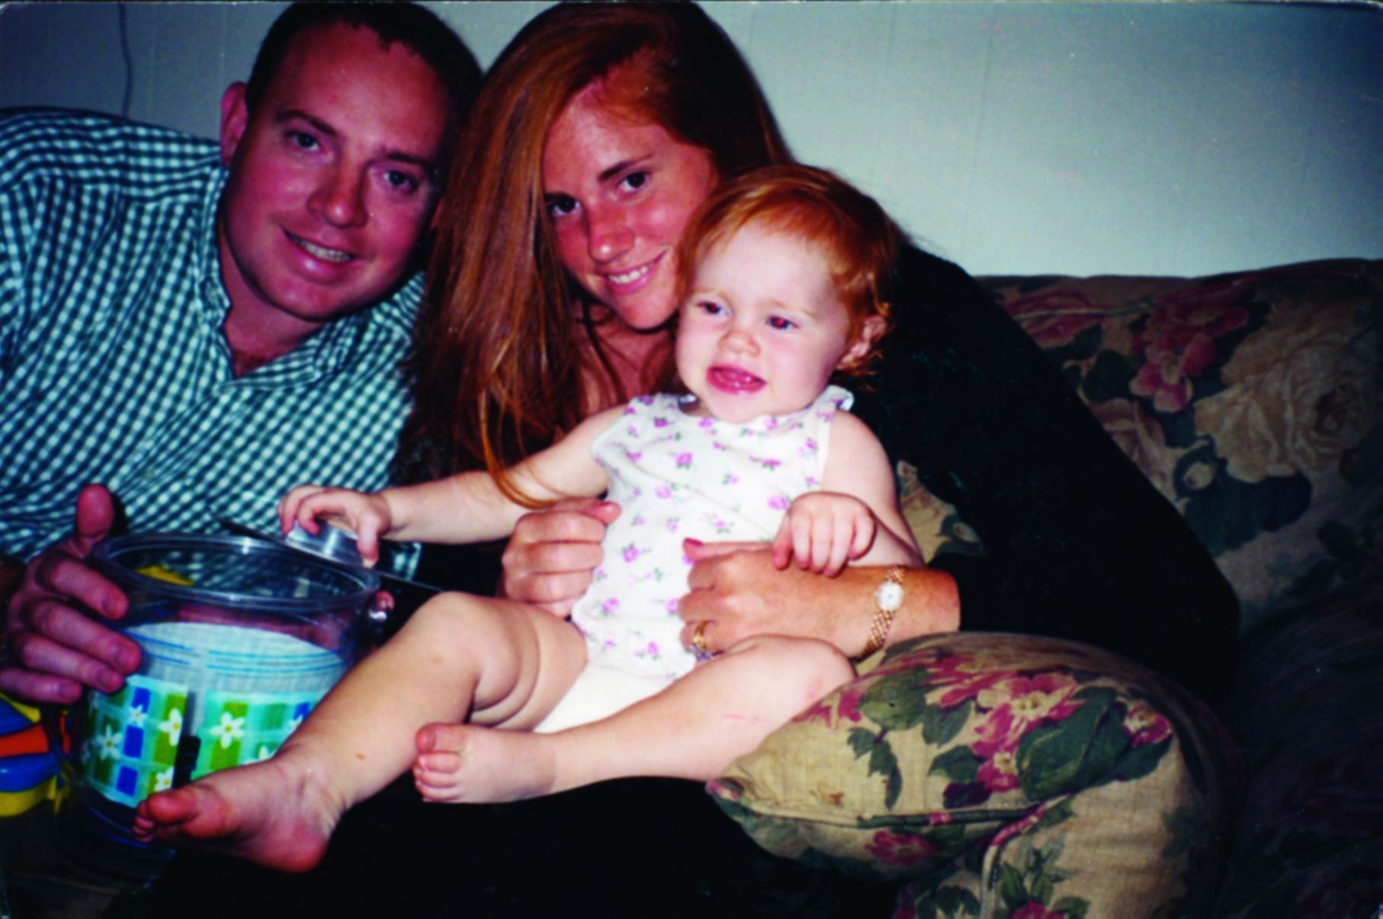
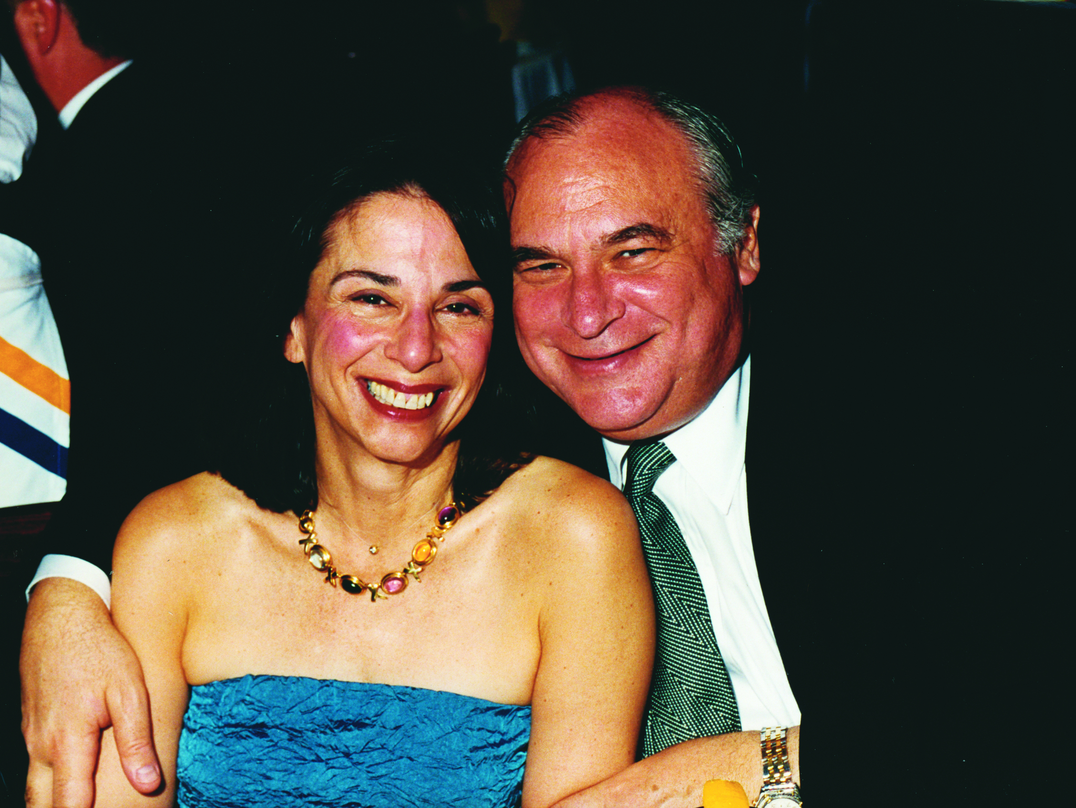
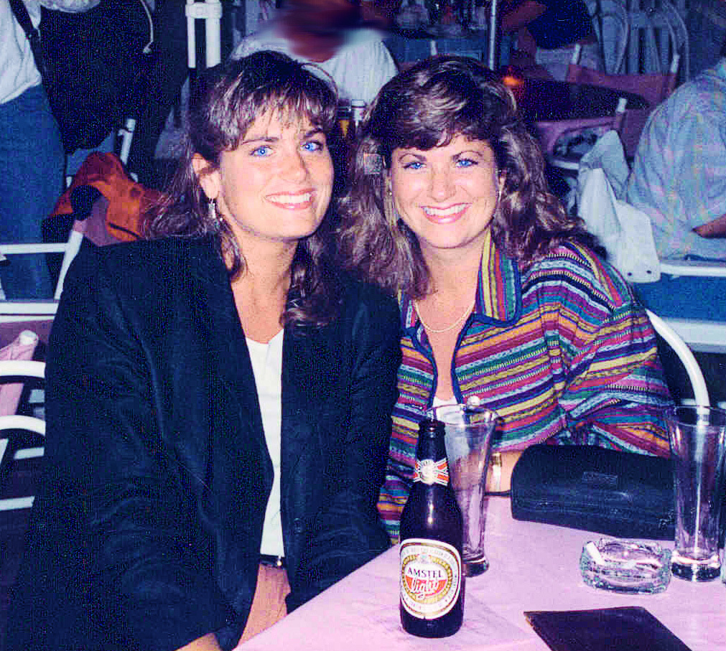
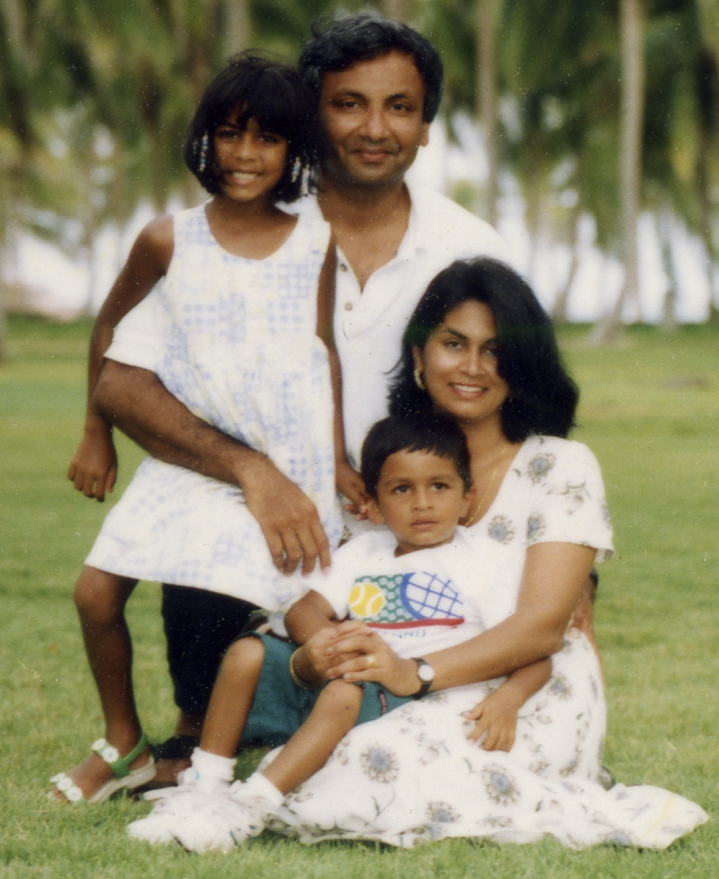
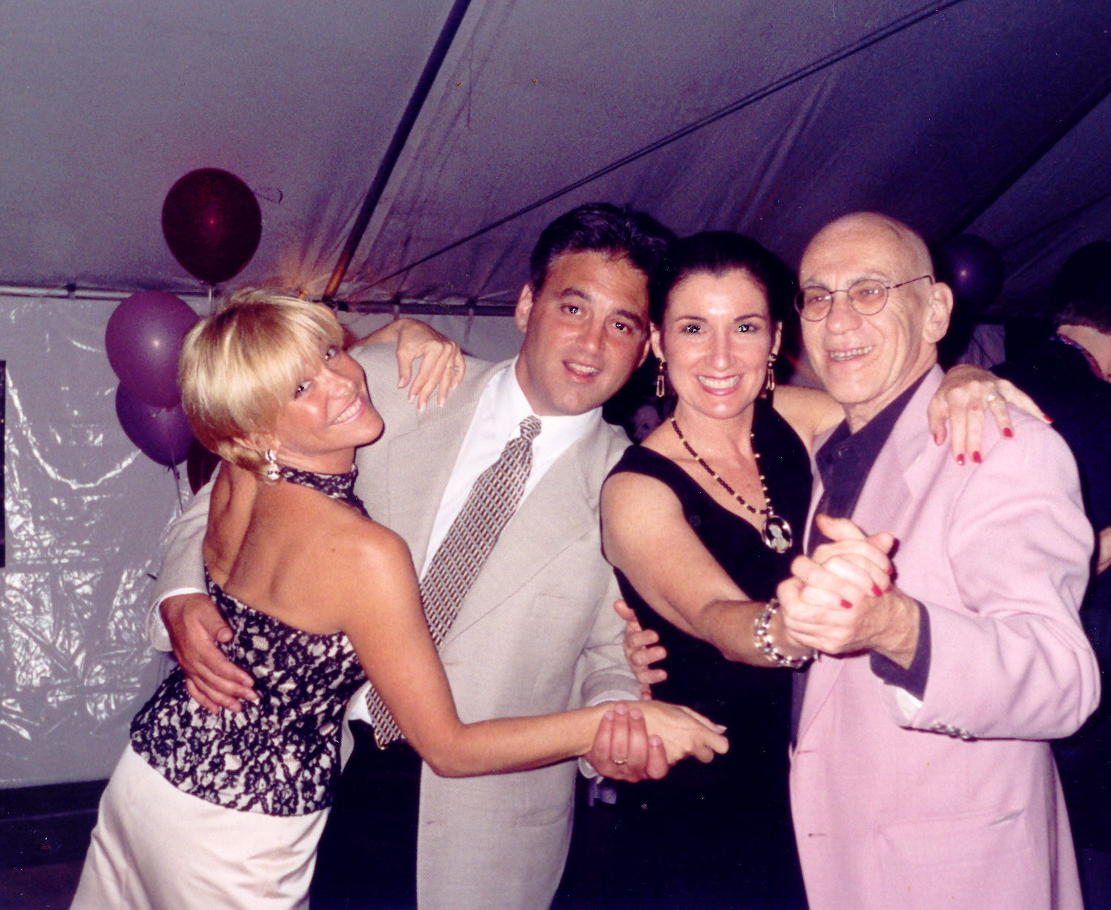
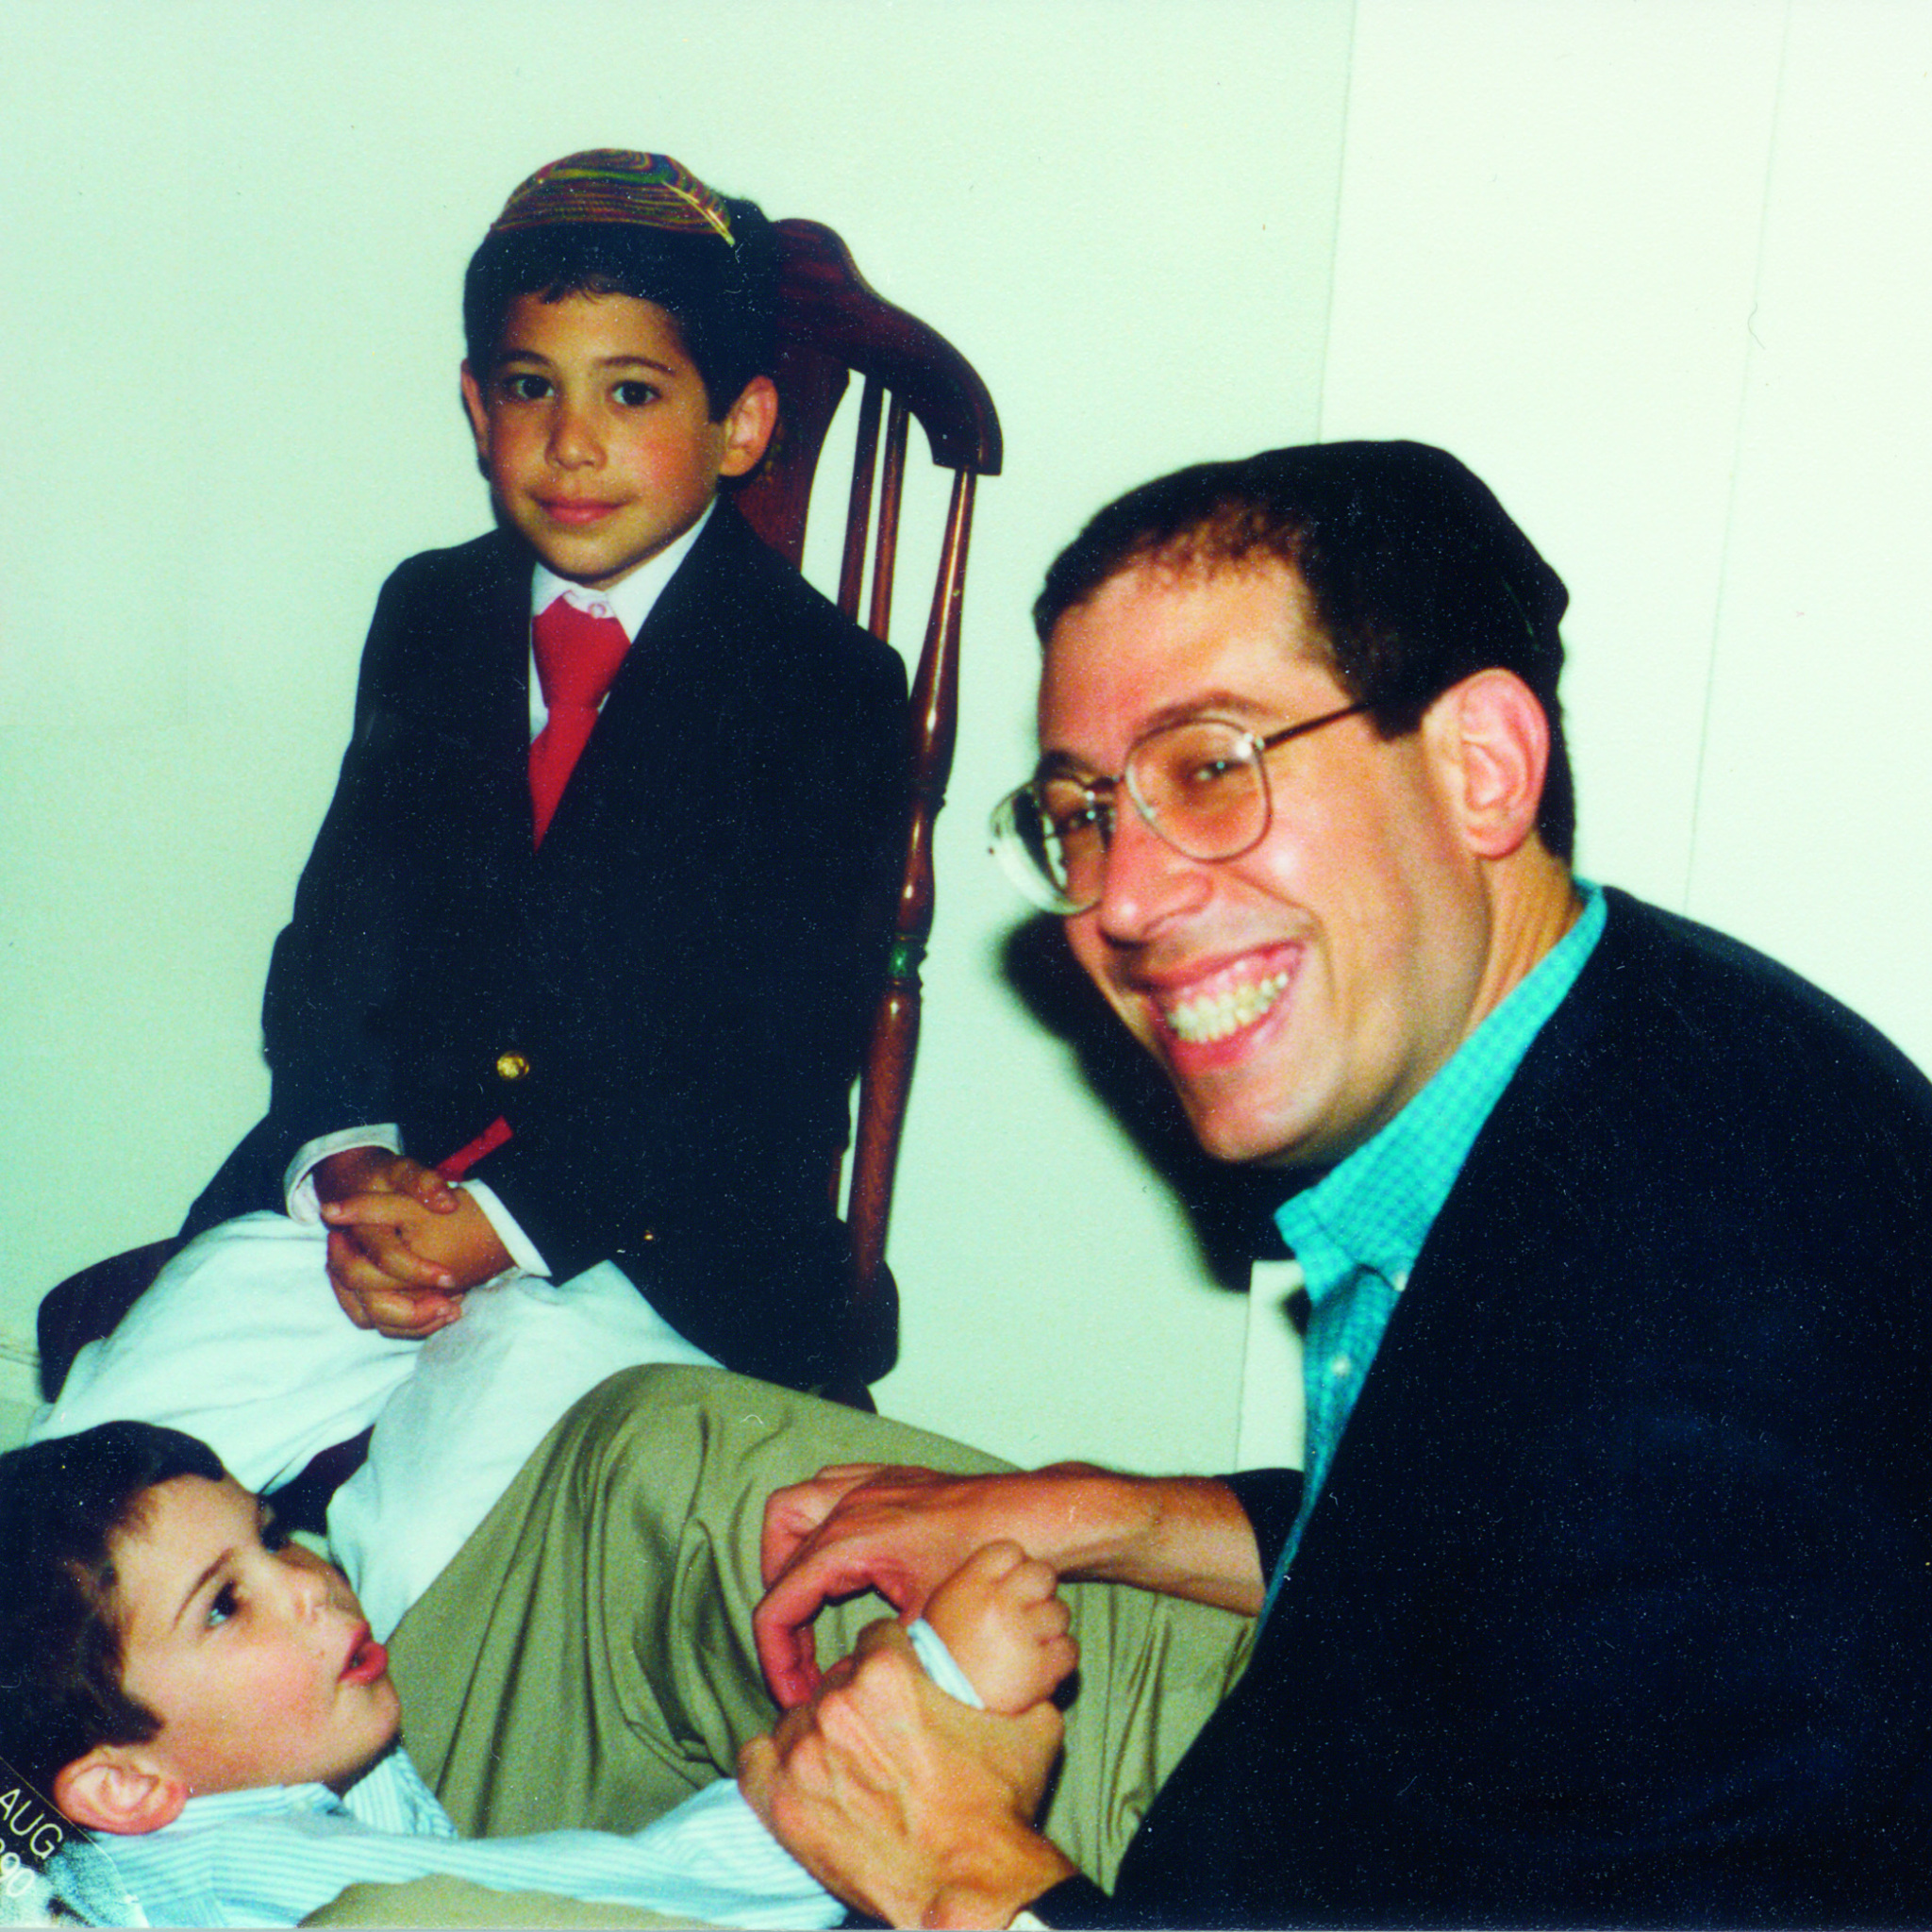
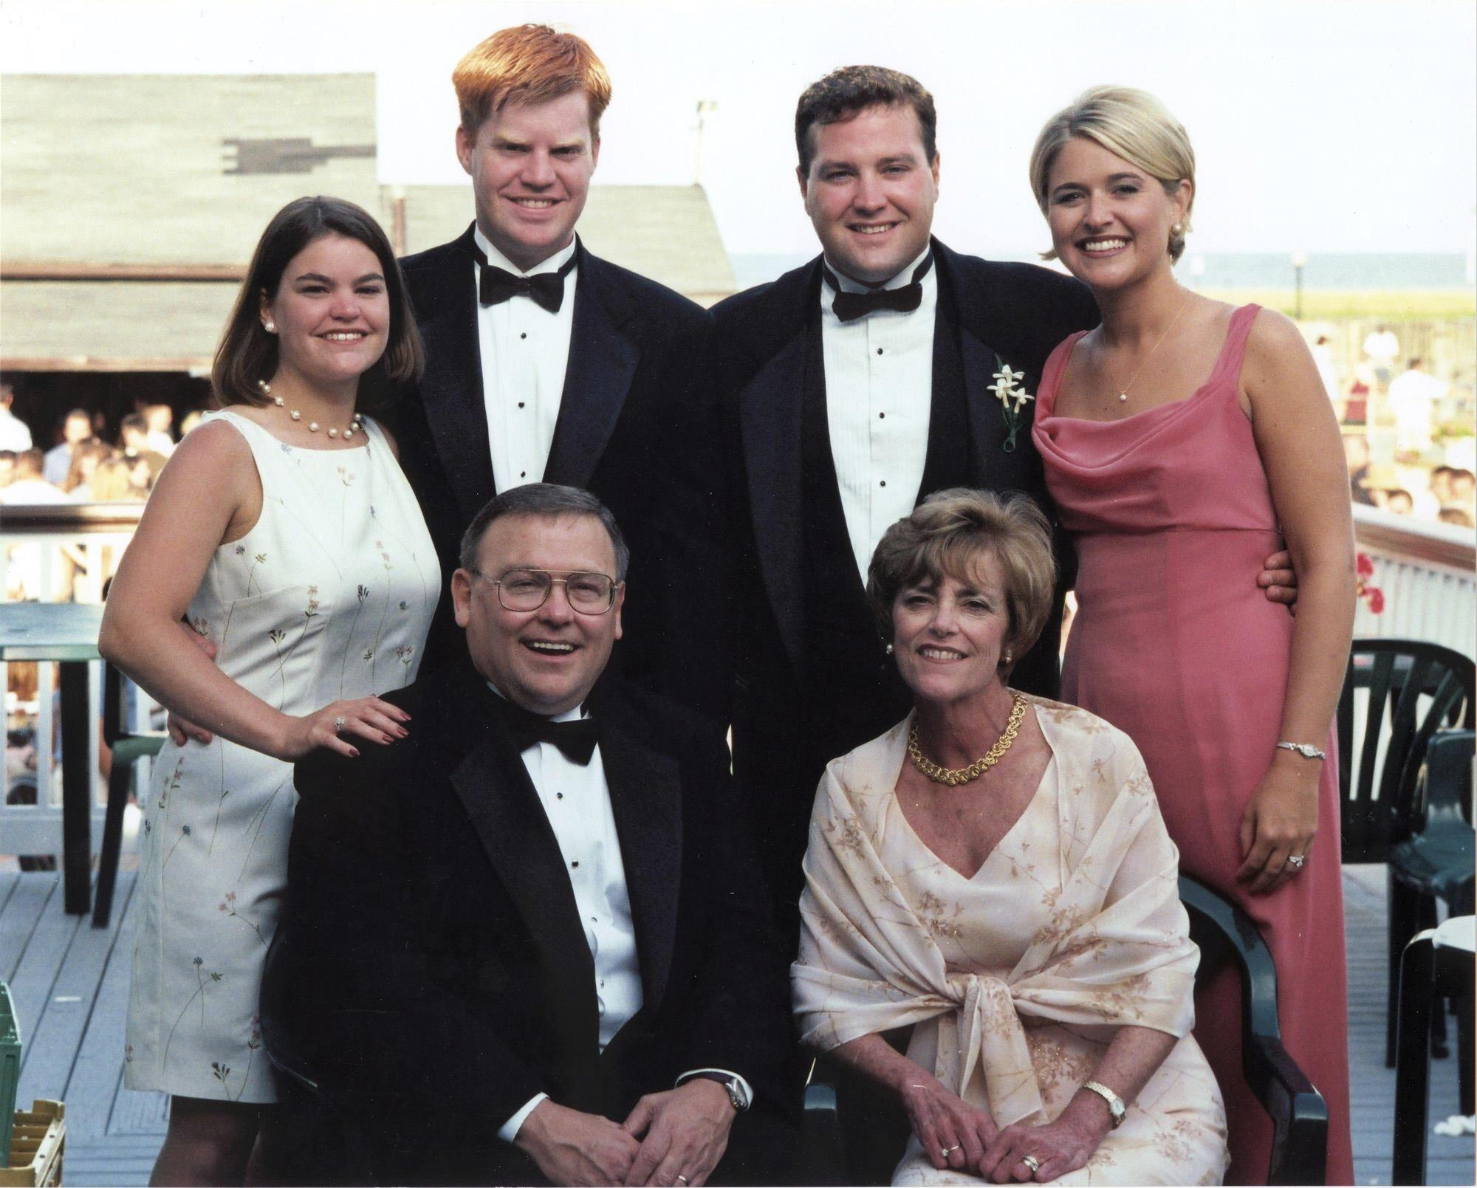
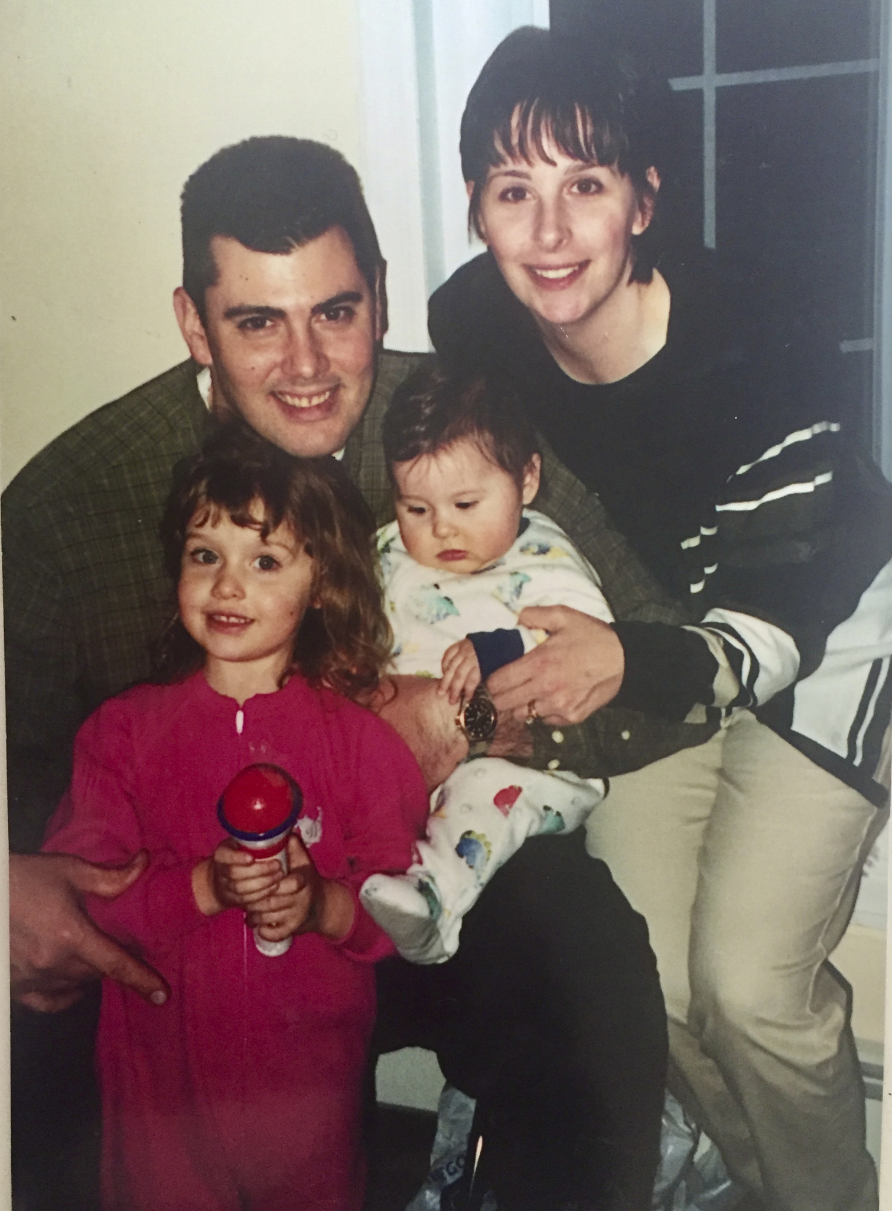
THE FAMILIES OF 9/11
Duration 16:15
LAUNCH VIDEO

Slide 8
SECTION 4
THE AFTERMATH
Duration 2:07
LAUNCH VIDEO

Slide 9
DISCUSSION: THE AFTERMATH
How do the changes that were made in security after 9/11 manifest themselves in our everyday lives?
Do you know anyone who has served in Afghanistan or Iraq? Have you ever talked with them about their service?
How has travel changed in this country post-9/11?
How can we work within our communities to combat hate?
Notes:
1. How do the changes that were made in security after 9/11 manifest themselves in our everyday lives?
2. Do you know anyone who has served in Afghanistan or Iraq? Have you ever talked with them about their service?
3. How has travel changed in this country post-9/11?
4. How can we work within our communities to combat hate?

Slide 10
ADDITIONAL INFORMATION AND HOMEWORK IDEAS

Slide 11
LOCAL HEROES
Duration 1:07
LAUNCH VIDEO

Slide 12
DISCUSSION: LOCAL HEROES
Discuss what it must have taken for Madeline Sweeney, Betty Ong, and Captain John Ogonowski to take the action they did in the face of danger.
What might have happened if they had not taken the action they did on that day?
Do you know someone who has done something heroic in the face of personal danger?
Notes:
1. Discuss what it must have taken for Madeline Sweeney, Betty Ong, and Captain John Ogonowski to take the action they did in the face of danger.
2. What might have happened if they had not taken the action they did on that day?
3. Do you know someone who has done something heroic in the face of personal danger?

Slide 13
RESCUE EFFORTS
Duration 1:11
LAUNCH VIDEO

Slide 14
DISCUSSION: RESCUE EFFORTS
Have you ever thought about what it takes for first responders to run INTO danger to save others?
Do any of you have relatives who are members of law enforcement, firefighters or paramedics?
What kind of training do you think someone would need to fight their own instinct to stay away from something dangerous?
Notes:
Have you ever thought about what it takes for first responders to run INTO danger to save others?
Do any of you have relatives who are members of law enforcement, firefighters or paramedics?
What kind of training do you think someone would need to fight their own instinct to stay away from something dangerous

Slide 15
ASSISTANCE FOR SURVIVORS
Duration 1:52
LAUNCH VIDEO

Slide 16
DISCUSSION: ASSISTANCE FOR SURVIVORS
Why do you think so many nonprofits were established in the wake of September 11th?
Have you ever participated in a Day of Service?
Notes:
1. Why do you think so many nonprofits were established in the wake of September 11th?
2. Have you ever participated in a Day of Service?

Slide 17
LOCAL MEMORIALS
Duration 2:50
LAUNCH VIDEO

Slide 18
DISCUSSION: LOCAL MEMORIALS
Why are memorials important?
Can you think of a memorial you have visited that had meaning for you?
What do you think is the significance of the Survivor Tree?
When terrible things happen, can you think of a way to make things better for someone?
What might you do during a Day of Service to honor the victims of September 11th?
Notes:
Why are memorials important?
2. Can you think of a memorial you have visited that had meaning for you?
3. What do you think is the significance of the Survivor Tree?
4. When terrible things happen, can you think of a way to make things better for someone?
5. What might you do during a Day of Service to honor the victims of September 11th?

Slide 19
SECTION 9
HOMEWORK IDEAS

Slide 20
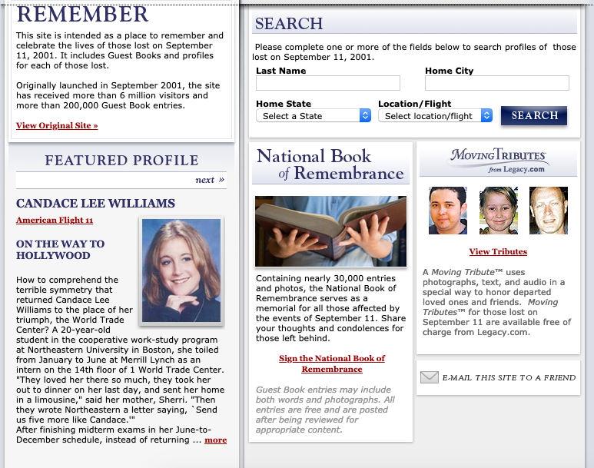
DISCUSSION: HOMEWORK IDEAS
Pick one of the 206 local victims of 9/11 and find out who they were and what they did before September 11th, 2001.
Here is a link to their legacy profiles:
www.legacy.com/sept11/home.aspx
Notes:
Pick one of the 206 local victims of 9/11 and find out who they were and what they did before September 11th, 2001. Here is a link to their legacy profiles. www.legacy.com/sept11/home.aspx

Slide 21
DISCUSSION: MORE HOMEWORK IDEAS
Contact a local veteran of Iraq or Afghanistan and talk with them about their experiences in those wars. What has it been like to come home?
Research local memorials. Find out:
How were they created?
Where did the money come from?
How are they maintained?
Discuss the tendency to blame an entire group for the actions of a few. Can you think of other examples where this happens?
Report on a service project you participated in and how it impacted you.
Discuss why doing good for others can sometime be therapeutic.
Notes:
Contact a local veteran of Iraq or Afghanistan and talk with them about their experiences in those wars. What has it been like to come home?
2. Research local memorials: Find out:
How were they created?
Where did the money come from?
How are they maintained?
3. Discuss the tendency to blame an entire group for the actions of a few. Can you think of other examples where this happens?
4. Report on a service project you participated in and how it impacted you.
5. Discuss why doing good for others can sometime be therapeutic.

Slide 22
For more information or to have a 9/11 family member speak at your school, please email:
education@massfund.org
This Education and Teaching Resource cannot be distributed or posted on social media without the express written consent of the Massachusetts 9/11 Fund.

